Slide 1
IT ticket analysis

Slide 2
Agenda
Problem Statement
Data Overview
Analysis with visuals
Final Recommendation
Data visualization(Dashboard)
Summary

Slide 3
Problem statement
To analyze the IT support ticket management system to understand the performance of IT agents, the efficiency of ticket resolution, and the satisfaction levels of employees.
The analysis aims to identify high and low performers among IT agents, assess the overall effectiveness of the team, and pinpoint areas for improvement in the ticket resolution process.
The ultimate goal is to make informed staffing decisions, including hiring, firing, and training, to enhance overall service quality and team performance.

Slide 4
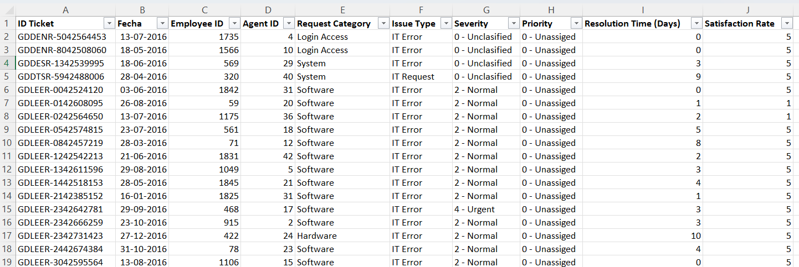
Data overview

Slide 5
The image above displays details about IT Ticket Information, including:
Tickets Sheet: Contains information about IT support tickets.
ID: Unique identifier for the ticket.
Ticket Fecha : Date of the ticket.
Employee ID: ID of the employee who raised the ticket.
Agent ID: ID of the agent assigned to the ticket.
Request Category: Category of the request (e.g., Login Access, System, Software).
Issue Type: Type of issue (e.g., IT Error, IT Request).
Severity: Severity of the issue
Priority: Priority level of the issue.
Resolution Time (Days): Time taken to resolve the ticket.
Satisfaction Rate: Satisfaction rate provided by the employee (1-5 scale).
IT Agents: Contains information about IT agents.
Agent ID: Unique identifier for the agent.
Full Name: Full name of the agent.
Email: Email address of the agent.
Year of Birth: Year the agent was born.
Month of Birth: Month the agent was born.
Day of Birth: Day the agent was born.

Slide 6
TREND ANALYSIS
INSIGHTS:
Ticket volumes grew steadily year‑over‑-year—doubling from 13K in 2016 to nearly 29K in 2020—indicating rapid scaling needs.
RECOMMENDATION:
Build out automated triage, self‑service, and analytics-driven workflows to manage this sustained growth effectively.

Slide 7
TICKET DISTRIBUTION BY SEVERITY TYPE
INSIGHT:
The majority of tickets are classified as "Normal" (88,656), with fewer in "Minor" (2,258), "Major" (4,836), and "Urgent" (1,392), suggesting that most issues are routine and non-critical.
RECOMMENDATION:
Implement a triage system to accurately classify and prioritize tickets, ensuring that urgent and major issues are addressed promptly while routine issues are managed efficiently.

Slide 8
RESOLUTION TIMES BY REQUEST CATEGORY.
INSIGHT:
Complex infrastructure (Hardware/System) tickets take 2–3× longer to resolve than software and 20× longer than login issues.
RECOMMENDATION:
Upgrading software tools as it is highly likely to reduce resolution times.

Slide 9
DISTRIBUTION OF TICKET BY REQUEST CATEGORY
INSIGHT:
Ticket distribution shows most issues fall under system (39k) and login access (29k), with fewer software and hardware tickets.
RECOMMENDATION:
Strengthen knowledge base (well-structured, searchable, user‑friendly) and upskill agents through regular training and SOPs to speed up resolution and reduce repeat issues.

Slide 10
AGE SEGMENT ANALYSIS
INSIGHTS:
Average satisfaction (~3.9/5) dips slightly with agents on 41–50 age range, with the <50 segment showing a boost (~4.4).
RECOMMENDATION:
Targeted training for agents with age group 41-50 to address skill gaps and improve efficiency.

Slide 11
SATISFACTION RATE OVER TIME
INSIGHT:
Customer satisfaction has shown a steady increase from 3.98 in 2016 to 4.16 in 2020, indicating consistent improvement over the years.
RECOMMENDATION:
To maintain this upward trend, focus on personalized customer interactions, streamline support processes, and proactively address customer concerns to further enhance satisfaction levels.

Slide 12
TICKET DISTRIBUTION ON SATISFACTION RATE
INSIGHT:
The majority of customers rate their satisfaction as 5 (51.9%) or 1 (10.2%), with fewer ratings in the middle, suggesting a polarized customer experience.
RECOMMENDATION:
Focus on understanding and addressing the reasons behind the extreme ratings (both positive and negative) to enhance overall customer satisfaction.

Slide 13
TICKET DISTRIBUTION ON RESOLUTION TIME
INSIGHT:
Ticket resolution times vary significantly, with many tickets resolved in 0–3 days, but a substantial number taking 4+ days, indicating potential inefficiencies or complex issues.
RECOMMENDATION:
Analyze and address bottlenecks causing delays, such as complex issues or resource constraints, to improve overall resolution efficiency.

Slide 14
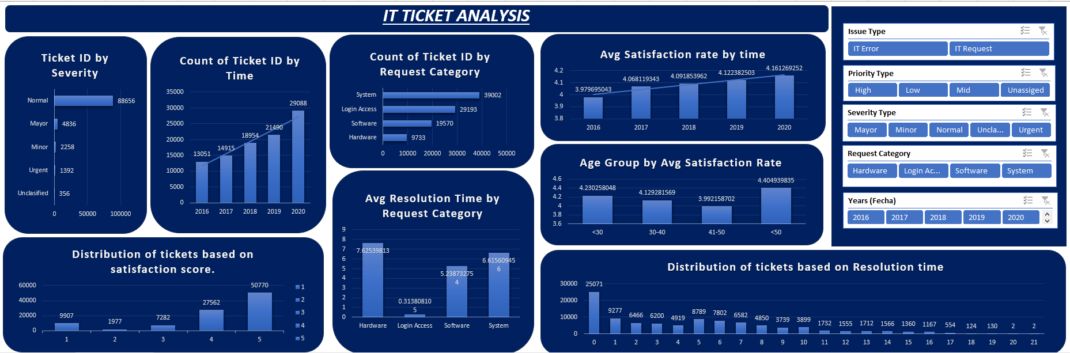
Data visualization

Slide 15
Final Recommendation
If there is an investment, it should be used in improving training programs as it will improve both resolution time and satisfaction quickly and it is low cost and high impact.
And if there is any excess investment left, it should be used in upgrading software tools. It is highly likely to reduce resolution times and improve satisfaction.
Provide targeted training for agents who have higher resolution time or lower satisfaction rate. Agents such as 3, 6, 19, 22, 25, 28 show lower ratios indicating both longer resolution time and lower satisfaction rate, they need to be fire.
Targeted training for age group 30-40 and 41-50 to address skill gaps and improve efficiency. Training could focus on problem solving and time management.
Prepare for peak ticket volumes by proactively scaling resources or implementing temporary processes like additional staff support or extended working hours.

Slide 16
Summary
Designed and developed an interactive dashboard to analyze IT support tickets using Excel.
Tracked KPIs like average resolution time, satisfaction score, ticket volume, and agent performance.
Applied slicers to enable dynamic filtering and user-friendly reporting.
Conducted trend analysis and performance segmentation to identify peak support hours and underperforming agents.
Presented actionable insights and recommendations to improve support operations, training needs, and tool efficiency.

Slide 17
Thank you
Surchand Laitonjam
25-06-2025

